Slide 1


Session1:
Intro to STM32
CUERT

Slide 2

CAIRO UNIVERSITY ECO-RACING TEAM
Embedded Systems Concepts
Agenda
1
Programming concepts
2
STM32 Cube IDE
3
MORE MILES TO ACHIEVE
WWW.CU-ECO.ORG

Slide 3
Embedded Systems
CAIRO UNIVERSITY ECO-RACING TEAM
Embedded Systems Concepts
Embedded Systems
Microcontroller Architecture
MORE MILES TO ACHIEVE
WWW.CU-ECO.ORG

Slide 4
Embedded Systems
CAIRO UNIVERSITY ECO-RACING TEAM
Embedded Systems Concepts
MORE MILES TO ACHIEVE
WWW.CU-ECO.ORG

Slide 5
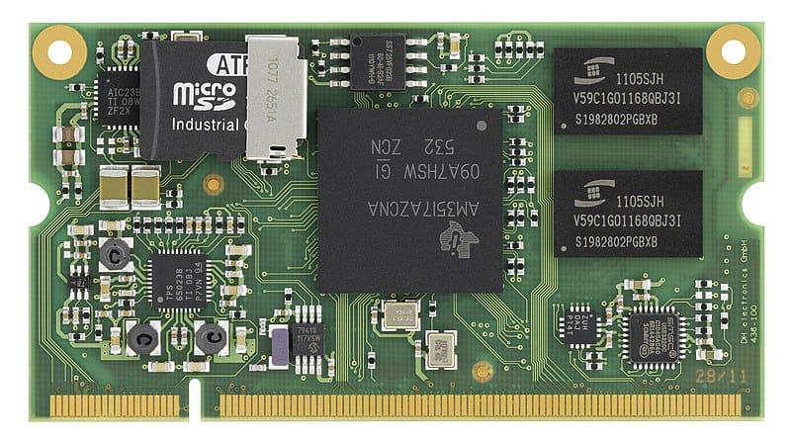
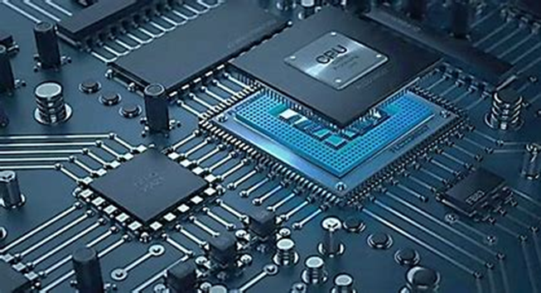
Embedded systems
CAIRO UNIVERSITY ECO-RACING TEAM
What’s an Embedded System
A combination of software and hardware
Performs a specific task as a part of larger system
MORE MILES TO ACHIEVE
WWW.CU-ECO.ORG

Slide 6


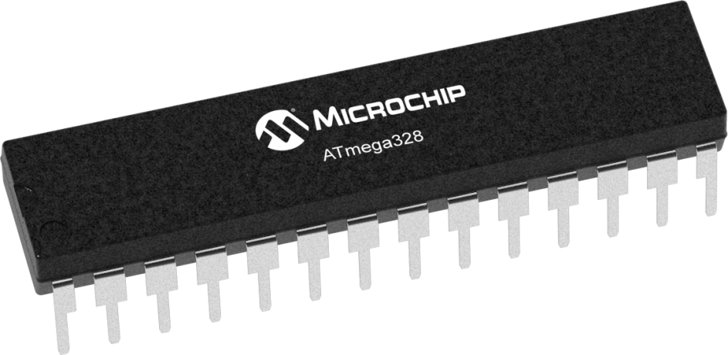

Embedded systems
CAIRO UNIVERSITY ECO-RACING TEAM
What’s an Embedded System
Embedded system is a system include software[Programing language] and hardware[Microcontroller]combination to Reach specific target.
Specific Target
Embedded System
MORE MILES TO ACHIEVE
WWW.CU-ECO.ORG

Slide 7
Embedded systems
CAIRO UNIVERSITY ECO-RACING TEAM
What’s an Embedded System
An embedded system is a specialized computing system designed to perform dedicated functions or tasks within a larger system. Unlike general-purpose computers, embedded systems are optimized for efficiency, reliability, and real-time performance.
Specific Target
Embedded System
MORE MILES TO ACHIEVE
WWW.CU-ECO.ORG

Slide 8
Embedded systems
CAIRO UNIVERSITY ECO-RACING TEAM
Embedded system and computing system
Embedded system | computing system
Specialized system designed for a specific task | System designed for multiple tasks and user interactions
Optimized for low power consumption | Higher power requirement
Ex: washing machines, ATMs , automotive ECUs | Ex : Laptops, desktops, smartphones
MORE MILES TO ACHIEVE
WWW.CU-ECO.ORG

Slide 9
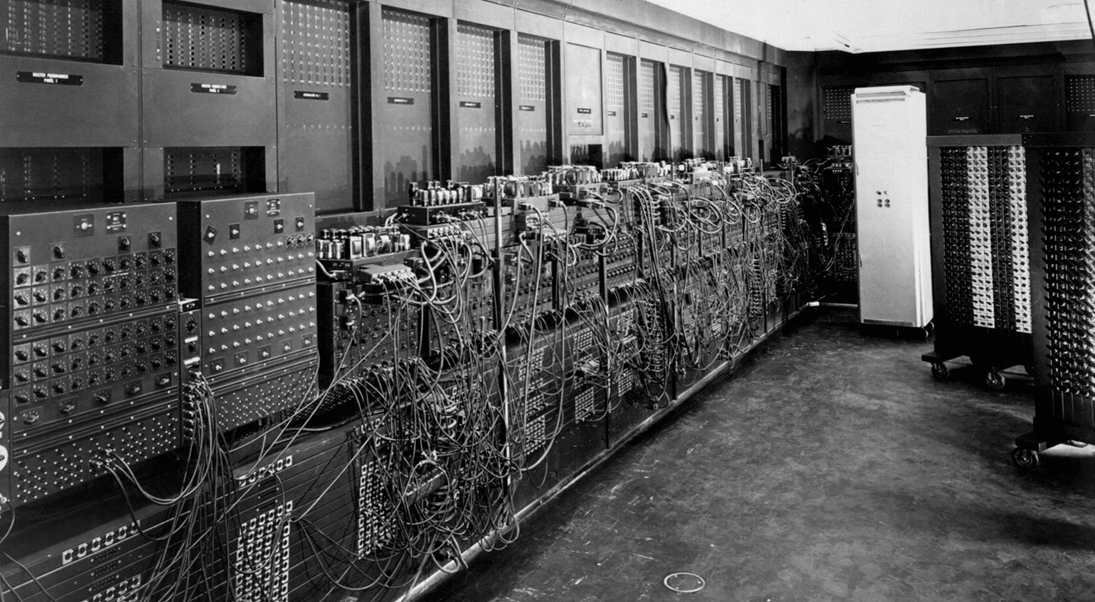
Embedded systems
CAIRO UNIVERSITY ECO-RACING TEAM
Historic PC
MORE MILES TO ACHIEVE
WWW.CU-ECO.ORG

Slide 10
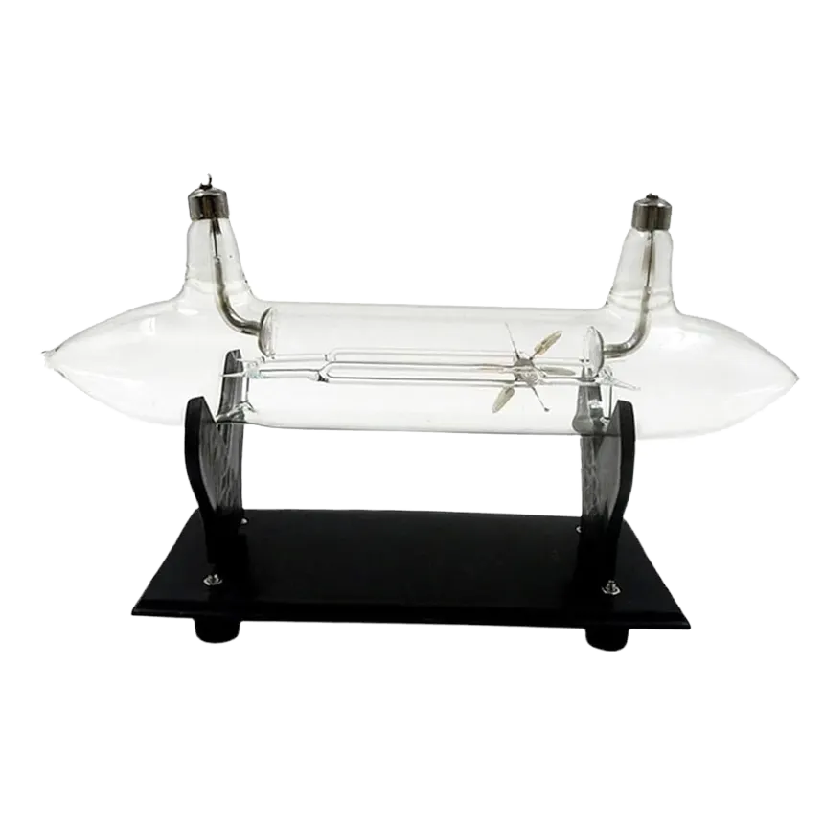
Embedded systems
CAIRO UNIVERSITY ECO-RACING TEAM
Cathode Tube
It were used before transistors and used a lot of energy and area
MORE MILES TO ACHIEVE
WWW.CU-ECO.ORG

Slide 11
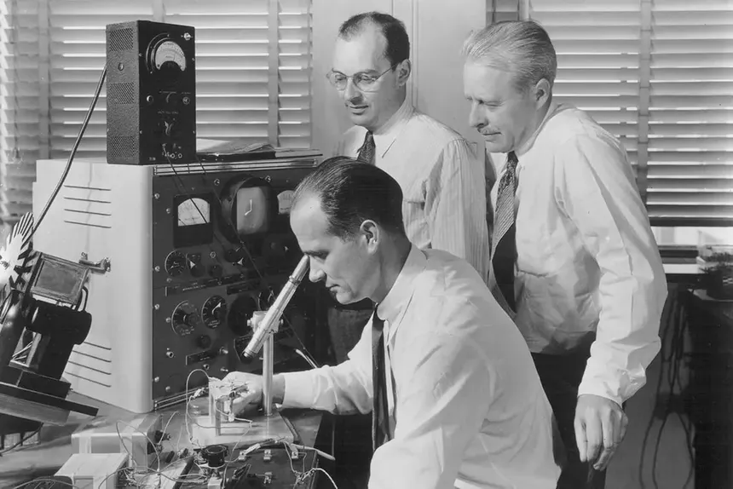
Embedded systems
CAIRO UNIVERSITY ECO-RACING TEAM
Historic Transistor
MORE MILES TO ACHIEVE
WWW.CU-ECO.ORG

Slide 12
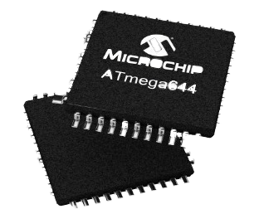
Embedded systems
CAIRO UNIVERSITY ECO-RACING TEAM
IC Chip
IC is Integrated Circuit is an assembly of electronic components like capacitors and resistors to perform a specific function like AND gate IC
Has different shapes but its function is known from the number printed on it and its data sheet not from its shape
MORE MILES TO ACHIEVE
WWW.CU-ECO.ORG

Slide 13
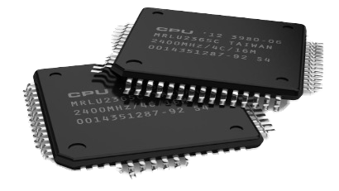
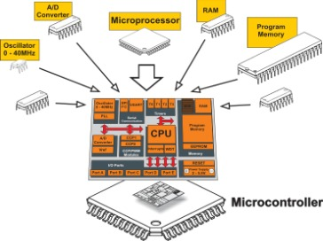
Embedded systems
CAIRO UNIVERSITY ECO-RACING TEAM
Microprocessor vs Microcontroller
It is the brain of the system
Consist of CPU only
It is a small computer on single integrated circuit containing
MORE MILES TO ACHIEVE
WWW.CU-ECO.ORG

Slide 14
Embedded systems
CAIRO UNIVERSITY ECO-RACING TEAM
Microprocessor vs Microcontroller
MPU | MCU
A processing unit that requires external memory and peripherals | A compact integrated chip that includes a processor, memory and peripherals
Used in computing systems for general-purpose tasks | Used in embedded systems for specific tasks
High power consumption | Low power optimized for energy efficiency
MORE MILES TO ACHIEVE
WWW.CU-ECO.ORG

Slide 15
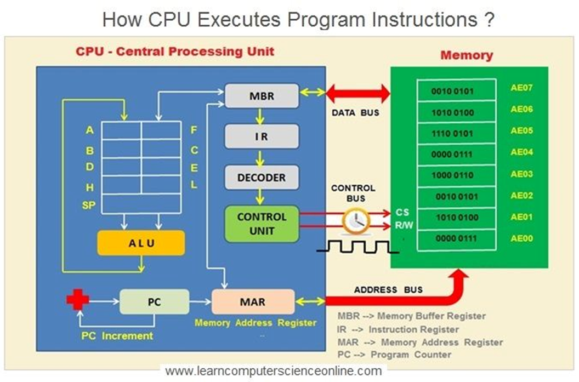
Embedded systems
CAIRO UNIVERSITY ECO-RACING TEAM
d. How a microprocessor works
1-Code Writing & Compilation
2-Code Upload to Flash Memory
3-Power-On & Reset Process
4-Fetch-Decode-Execute Cycle
5-Interrupt Handling (If Required)
6-Continuous Execution
MORE MILES TO ACHIEVE
WWW.CU-ECO.ORG

Slide 16
Embedded systems
CAIRO UNIVERSITY ECO-RACING TEAM
d. How a microprocessor works
1-Code Writing & Compilation
2-Code Upload to Flash Memory
3-Power-On & Reset Process
4-Fetch-Decode-Execute Cycle
5-Interrupt Handling (If Required)
6-Continuous Execution
MORE MILES TO ACHIEVE
WWW.CU-ECO.ORG

Slide 17
Embedded Systems
CAIRO UNIVERSITY ECO-RACING TEAM
Microcontroller Architecture
MORE MILES TO ACHIEVE
WWW.CU-ECO.ORG

Slide 18
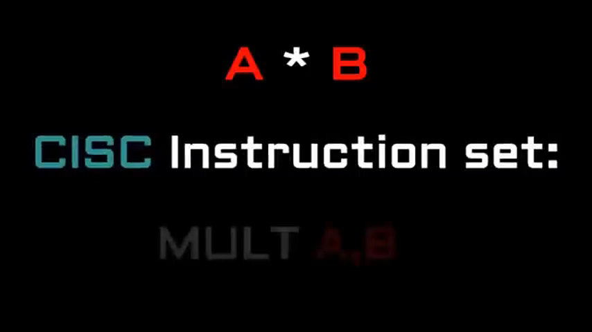
Microcontroller
CAIRO UNIVERSITY ECO-RACING TEAM
CISC vs RISC
MORE MILES TO ACHIEVE
WWW.CU-ECO.ORG

Slide 19
Microcontroller
CAIRO UNIVERSITY ECO-RACING TEAM
CISC vs RISC
MPU | MCU
A processing unit that requires external memory and peripherals | A compact integrated chip that includes a processor, memory and peripherals
Used in computing systems for general-purpose tasks | Used in embedded systems for specific tasks
High power consumption | Low power optimized for energy efficiency
MORE MILES TO ACHIEVE
WWW.CU-ECO.ORG

Slide 20
TEAM TIME
CAIRO UNIVERSITY ECO-RACING TEAM
Autonomous subteam
Autonomous development
Autonomous embedded
MORE MILES TO ACHIEVE
WWW.CU-ECO.ORG

Slide 21

CAIRO UNIVERSITY ECO-RACING TEAM
57% passed
MORE MILES TO ACHIEVE
WWW.CU-ECO.ORG

Slide 22

Thank You Slide
MORE MILES TO ACHIEVE
WWW.CU-ECO.ORG

